Slide 1
Useful Microbes

Slide 2
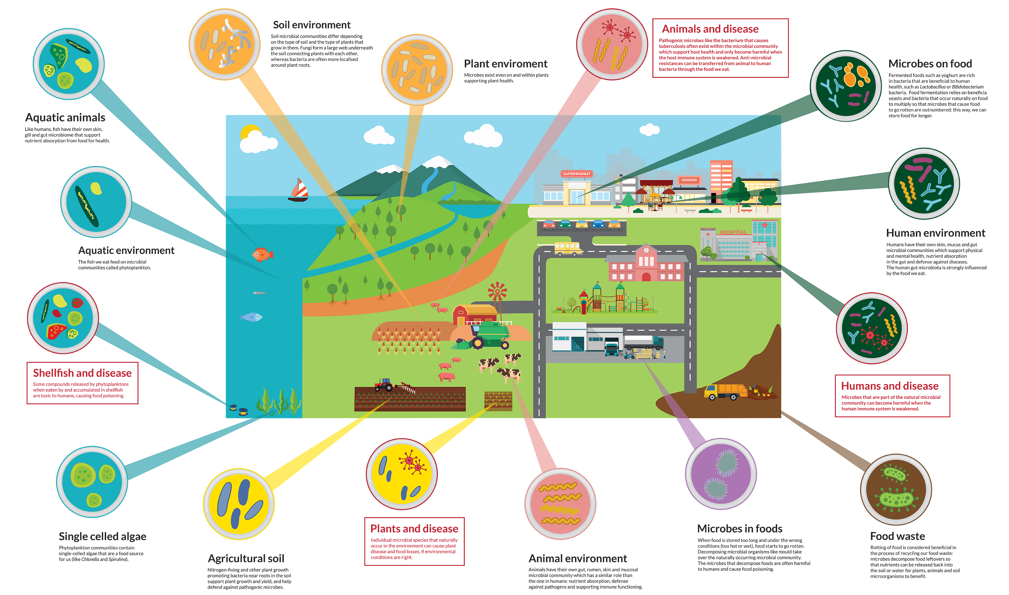
Useful Microbes

Slide 3
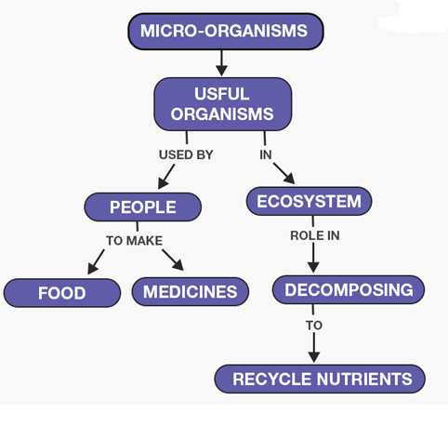
Useful Microbes

Slide 4
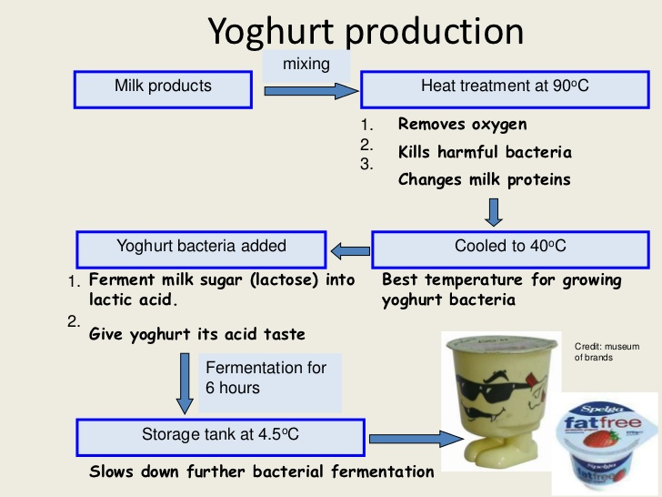

Slide 6
https://www.youtube.com/watch?v=9HOk8A-j4Es

Slide 10
https://www.youtube.com/watch?v=-muIoWofsCE

Slide 12
https://www.youtube.com/watch?v=cjSE73S3Crs

